Slide 1


Operating Conditions and Profiles
Shipboard Power System Fundamentals
Revision of 6 January 2026
Dr. Norbert Doerry
http://doerry.org/norbert/MarineElectricalPowerSystems/index.htm
© 2026 by Norbert Doerry
This work is licensed via: CC BY 4.0 (https://creativecommons.org/)

Slide 2
Essential Questions
What is an operational condition and what is an operational profile? | Understand
What are operational conditions and operational profiles used for? | Understand
How are Operating conditions and operational profiles created? | Apply
What are the implications of an operational condition and profile on design? | Understand

Slide 3
Introduction
A representation of the physical ship is often insufficient to predict performance of the ship. Other possible factors include:
  The environment the ship operates in (not the subject of this presentation)
  Different ways the ship is intended to be used – Operating (or operational) conditions.
    Incorporates a list of what equipment is intended to be online and operational
    Percentage of time (when in operating condition) equipment is intended to be online and operational.
  The percentage of time that the ship is in each operating condition – Operating Profile
    The operating profile may initially be expressed by scheduling one of various operational modes to each month.
      Profile may be over an extended period of time (1 year to service life of the ship)
    The operational mode in turn is expressed as a percentage of time spent in each operating condition.
    Operating (Operational profile) derived from the schedule and operational mode definitions.
Each type of analysis may have different sets of operating conditions and profiles.
  May use different terms for operating (operational) conditions and profiles.

Slide 4
Examples of types of Analyses
Electric Power Load Analysis
  Determine required power (current) rating of power system equipment.
    Generator sets, switchboard bus bars, bus ties, transformers, power electronic converters, shore power connection.
  DPC 310-1 or IEEE Std 45.1
Endurance Fuel Calculations
  Determine the required size of fuel tanks.
  DPC 200-1
Annual Fuel Calculations
  Estimate the amount of fuel consumed each year
  Used as part of calculating Total Ownership Cost estimates.
  DPC 200-2

Slide 5
Example: Annual Fuel Calculations
Operational Conditions
  Shore
  Anchor
  Underway – Peacetime cruising
  Underway – Wartime cruising
  Underway – Functional (may have more than one)
Operational Modes (assigns percentage of time in each operational condition)
  Presence and training at home
  Presence overseas
  Lesser contingencies
  Major Combat Operations (MCO)
  Maintenance and modernization
Operational Profile (Deployment and Employment profile)
  Assigns one operational mode to each month the ship is operational

Slide 6
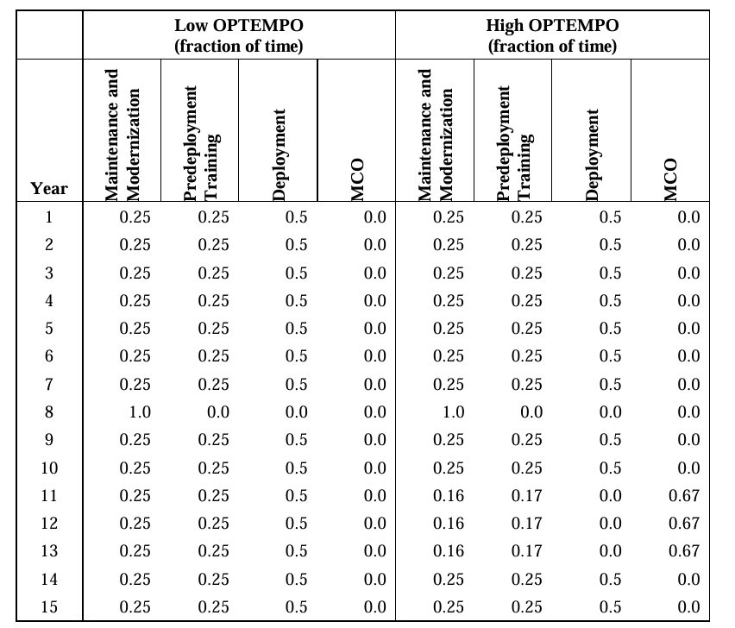
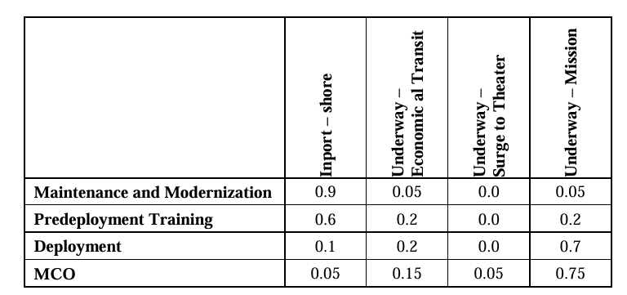
Example: Annual Fuel Calculations
Operating Conditions (states)
Operational
Modes
Operational Modes
Profile
Source: DPC 200-2

Slide 7
Creating Operational Conditions and Profiles
Model Based Systems Engineering
  Preferred method.
  Provide traceability to ship requirements.
  Requires the most knowledge of the ship design and operating practices.
  Often not resourced in early stages of design (if at all).
Analogy to other ships
  Use the EPLA and other documents from an existing ship (parent) and modify for a new design.
  Requires understanding of the parent design and the new design.
Load Factor tables in DPC 310-1 and IEEE 45.1
  Both tables are outdated.
  Provides “ballpark” values that may prove useful in early-stage design.
    For a complex or complicated ship, should not be used in preliminary design or later.
  Should only be used as a “last resort”.

Slide 8
Implications on design
Operating conditions and profiles used to calculate electrical load estimates.
  Electric load estimates directly impact elements of design:
    Fuel tank size
    Ratings of electrical power system components
If load estimate too low …
  Ship may not be able to meet its requirements, or …
  Extensive and expensive changes may be required.
  Particularly true if load estimates lead to choosing low voltage generation and distribution when a medium voltage solution is needed.
If load estimate too high …
  Expensive and unnecessary capacity may be designed into the system.
  Particularly true if load estimates force a transition to medium voltage generation and distribution when a low voltage solution is sufficient.

